Slide 1
Travelers Analytics Case Competition
Team : Time Travelers
Adwaith Ajith Menon
Nandita Krishnan
Sai Jahnavi Gamalapati

Slide 2
Index
Problem Statement
High Value Customer Definition
Data Pre-processing
Feature Engineering
Analysis and Findings
Recommendations
Conclusion
Q n A

Slide 3
Problem Statement
Blue Buffalo Insurance, a property casualty insurance company, wants help in identifying their high value customers through thorough analysis on historical customer data with respect to their demographics, telematics, and car details.
They also need recommendation on strategies to retain these high-valued customers to ensure the company’s revenue grows and profit increases.

Slide 4
Assumptions
The Annual Premium paid by a customer increases every year at a 5% rate, over the lifetime of the policy.
Annual Premium paid by the customer is not affected by whether or not a customer has made a claim.

Slide 5
High Value Customer

Slide 6
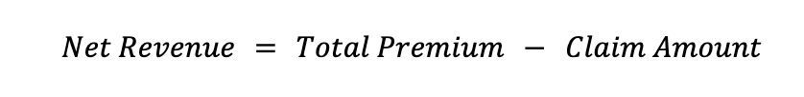
What defines a “high value” customer?
Based on our research, high-valued customers can be defined as the customers that contribute to 80% of the company’s net revenue where Net Revenue can be defined as:
Notes:
The Customer Lifetime Value is the net present value of a customer. It considers the difference between the total amount of revenues from a customer and the companies` expenses for this customer during the whole duration of relationship.
We have defined ‘High Value Customers’ as customers who contribute to 80 percent of the company’s positive net revenue.² Net revenue is defined as the difference between the total premium paid by the customer over the lifetime of the policy and the claim amount.

Slide 7
…where Total Premium can be given as follows:

Slide 8
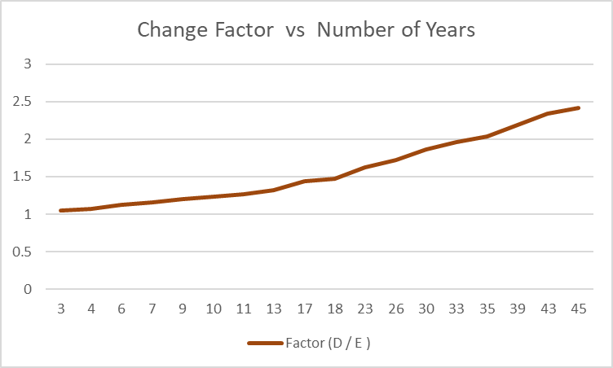
…and Change Factor is the variable included to account for the change in premium over the lifetime of a customer

Slide 9
Data Pre-Processing

Slide 10
Variables Excluded
auto_year
policy_nbr
zip_cd
state_cd
Some of the variables were excluded from the data set as they were redundant to the analysis

Slide 11
Feature Engineering

Slide 12
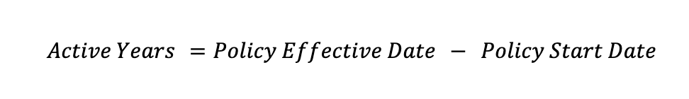
Active_Years
…obtained by calculating the difference between the start of the policy to the latest date for policy renewal

Slide 13
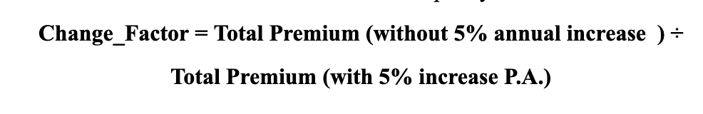
Change_Factor
… represents a coefficient that accounts for the change in Annual Premium over the lifetime of a policy

Slide 14
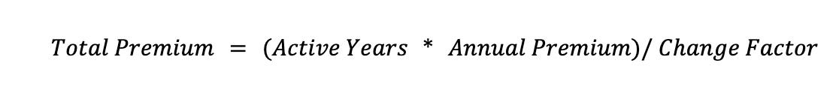
Total_Premium
… represents the total premium paid by a customer over the lifetime of the policy

Slide 15

Net_Revenue
… feature represents the revenue generated by the insurance company per policy

Slide 16
Car_type
Created variable car_type using a combination of auto_make and auto_model to identify the type of car insured by each customer
The cars have been classified into 5 types :
Compact SUV
Sedan
SUV
Sports Sedan
Truck

Slide 17

Negative_Peaks
Jerk/Jolt/Surge is defined as the change in acceleration with respect to time. When there is a huge change in acceleration, it is called High Jerk.

Slide 18
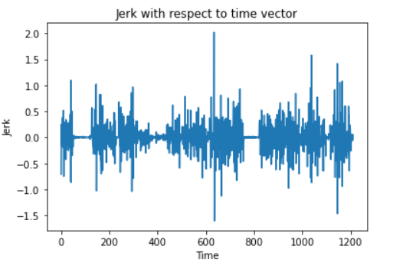
…and we utilized this formula to calculate the number of negative peaks encountered during a driver’s journey to identify rash driving, if any.

Slide 19
Analysis

Slide 20
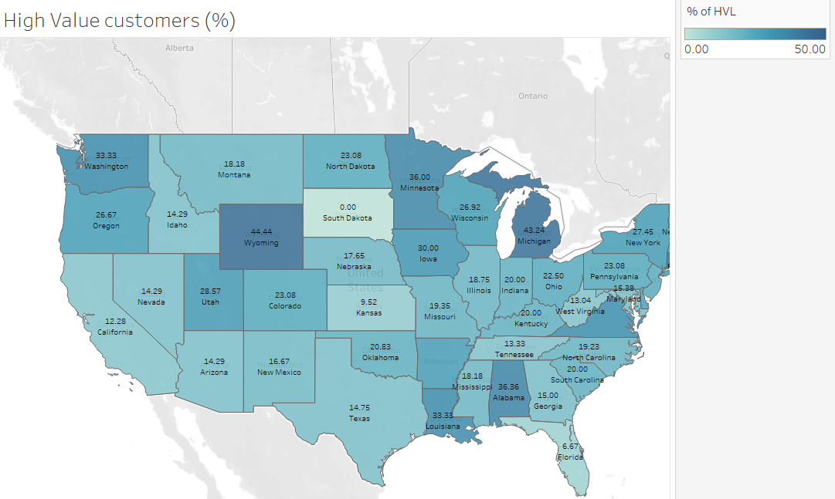
Distribution of high valued customers

Slide 21
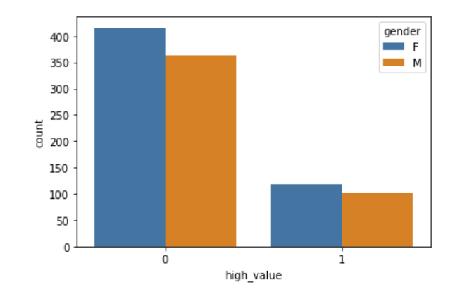
Gender Distribution among High Value Customers

Slide 22
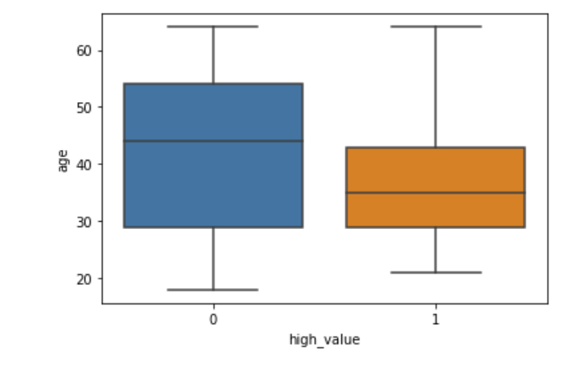
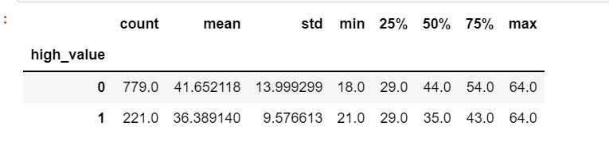
Age Distribution among High Value Customers

Slide 23
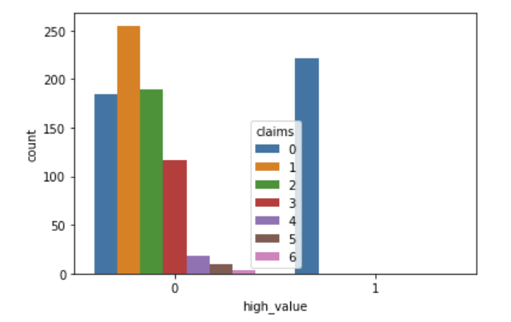
Differences in claims filed

Slide 24
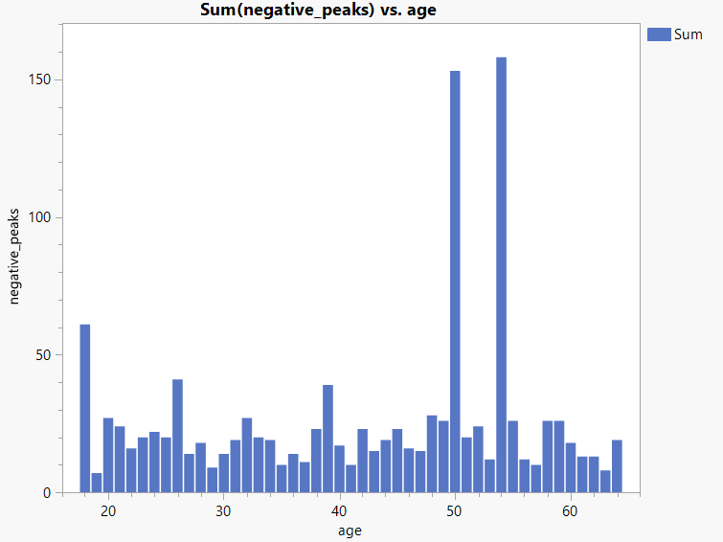
Effect of Age on Driver Behavior

Slide 25
Conclusions

Slide 26
Conclusion
Customers aged between 29 and 43 have proven to be most beneficial for Blue Buffalo
Michigan, Wyoming, Alabama, and Minnesota are some of the cities with greatest percentage of high valued customers
High Valued customers rarely have the tendency of getting into an accident or filing a claim.

Slide 27
Recommendations

Slide 28
Customer Retention Strategies
Provide additional support (home insurance) at discounted prices, to these high valued customers as a majority of these customers fall under the age bracket of 29 to 43 which also happens to be the age when most people become home-owners.
Provide No-Claim bonus for highly valued customers with no claims.
Direct maximum resources towards the high valued customers, by providing regular check-ins and personalized support to ensure customer satisfaction.

Slide 29
Acquisition of New Customers
Michigan, Wyoming, Alabama, and Minnesota account to a mere 9% of the entire customer base but consist of a huge percentage of the high valued customers. Targeted marketing should be done to acquire more customers from these states.
Utilize the list of high-valued customers in order to get referrals of other customers which leads to – low acquisition rate and potentially an increase in the number of high valued customers.

Slide 30
Thank You!

